Slide 1
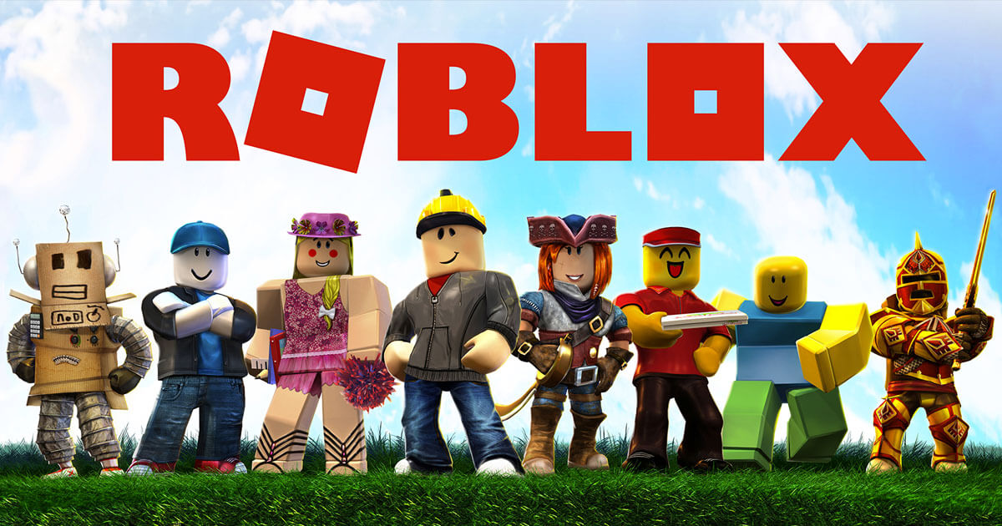
SHOWCASE WEEK

Slide 2
COURSE TIMELINE
Programming Projects with Lua
Roblox Studio Basics
Constraints Pt 1
Constraints Pt 2
Intro to Lua
Parameters
Loops & Conditionals
Functions
W1
W2
W3
W4
W5
W6
W7
W8

Slide 3

Edmodo
Resource Hub
Slides
Learning Material
Exercises/ Assignments / Quizzes
Tutorial Videos
WHEN TO CHECK
FRIDAY AFTERNOON EVERY WEEK
Communication
Directly message teachers
Post Questions
Post Screenshots of your work

Slide 4
TODAY’S LESSON
1
FINISHING OFF TERM PROJECT
2
REVIEW OF CONCEPTS
3
QUICK RUN THROGUH
4
SHOWCASE

Slide 5
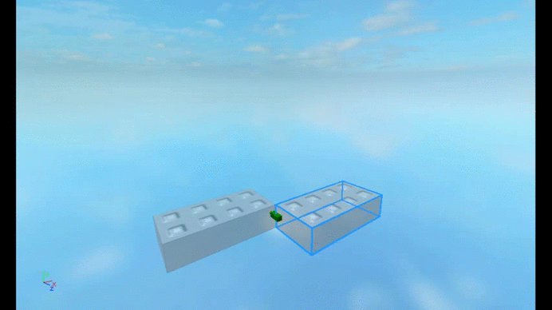
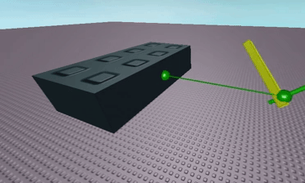
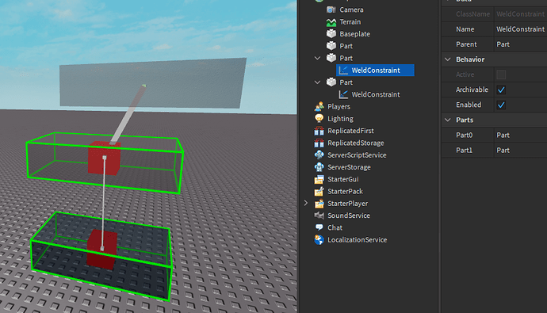
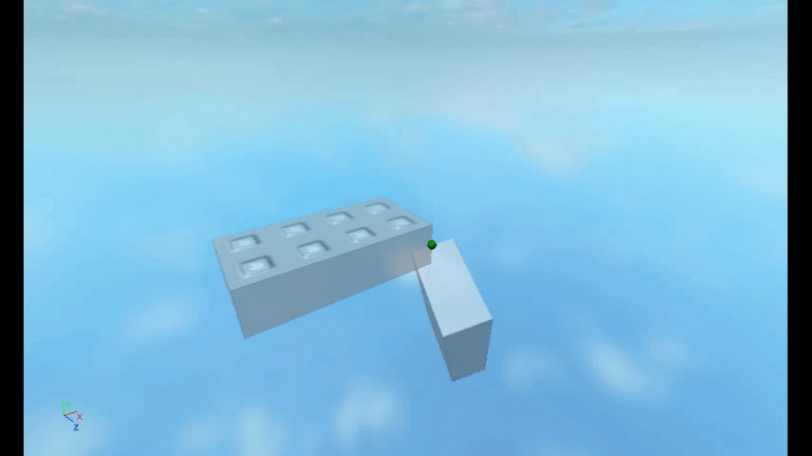
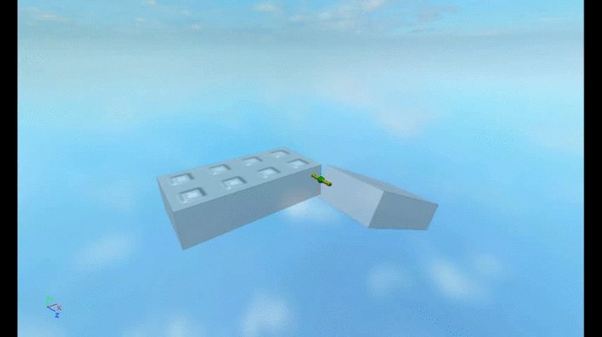
REVIEW: CONSTRAINTS
We use constraints to join two objects together.
TYPES OF CONSTRAINTS
BALL-IN SOCKET
HINGES
PRISMATIC
CYLINDRICAL
WELDS
Notes:
Go through real life examples (see worksheet Wk3)

Slide 6

REVIEW: VARIABLE?
102
Variables are useful for storing things that change
(i.e. things that "vary" - hence the word "variable")
Try changing fav_num to 102.
fav_num
Notes:
Let's say you’re in a big warehouse, with a lot of boxes. How will you be able to access or remember something that you put in one of the box?
LABEL THE BOX!!
Variables is like the label on the box. As humans, it is easier for us to remember a name or label than an exact block of information. Variables let us store information, recall and reuse them.

Slide 7
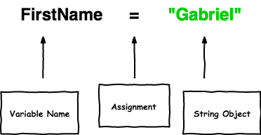
PARTS OF A VARIABLE?
Fav_num = 102

Slide 8

REVIEW CONDITIONAL
Conditions let us make decision.
First we test if the condition is met!
Then maybe we’ll do the thing
If it’s raining take an umbrella
Yep it’s raining
…... take an umbrella

Slide 9
IF/ ELSE STATEMENTS
fave_num = 15
if fav_num < 10:
print("What a great number")
elif fav_num = 11:
print("I love the number 11")
else:
print("I only like numbers below 11")
else
statements means something still happens if the if or elif statement was False

Slide 10
WHILE LOOPS
While Loops can repeat a task… literally forever!
At least…
until a condition is met that tells it to stop.
Typing 100 print statements is boring
solution: Use a while loop.

Slide 11
In other words...
A loop tells the computer how many times to run a piece of code.
What do you think this does?
>>> i = 0
>>> while i < 3:
... print("i is " + str(i))
... i = i + 1

Slide 12
CLASS PROJECT
SHOWCASE

